Slide 1



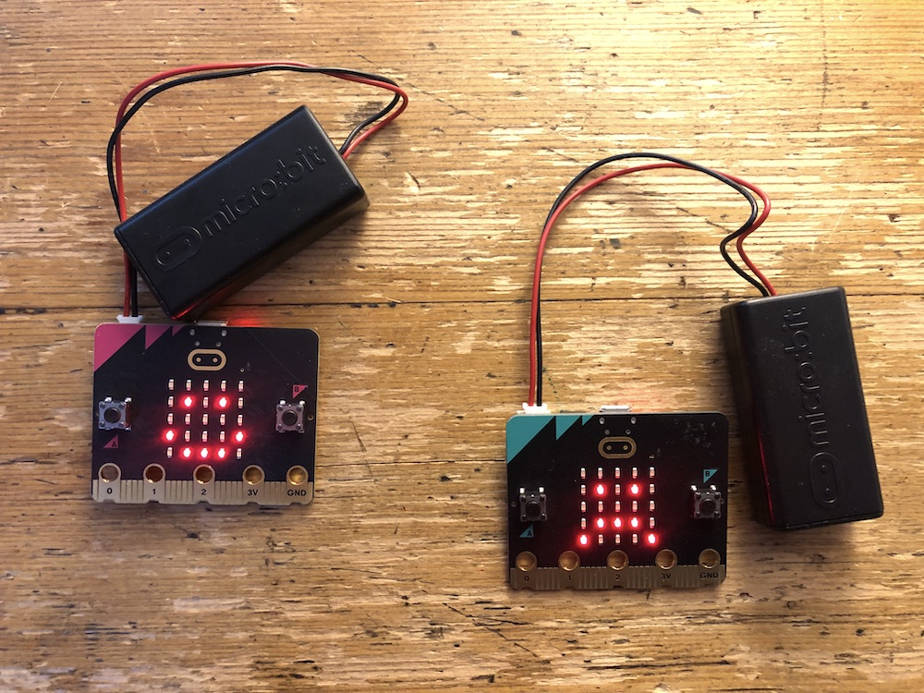


Lesson 3 Emotion badge

Slide 2
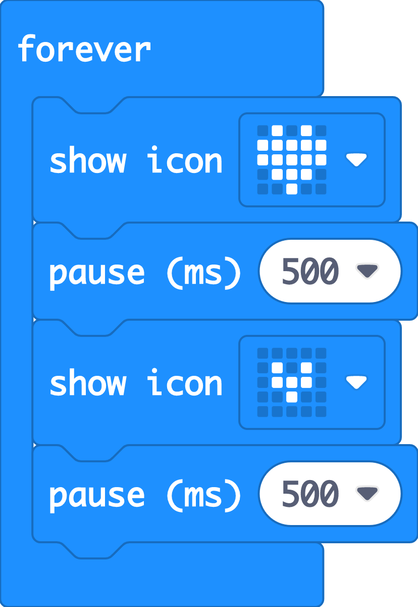
Recap: what did we discover about animations?
Last time we used sequences of instructions code animations on the micro:bit’s LED display output.
We used the ‘forever’ loop block to keep the animation running.
The micro:bit’s display, even though it only has 25 LEDs, can show pictures that represent real things like hearts or animals.

Slide 3





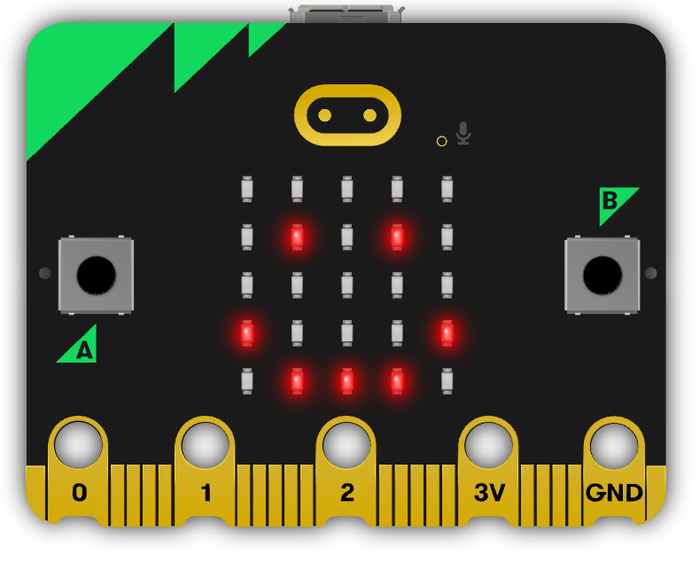
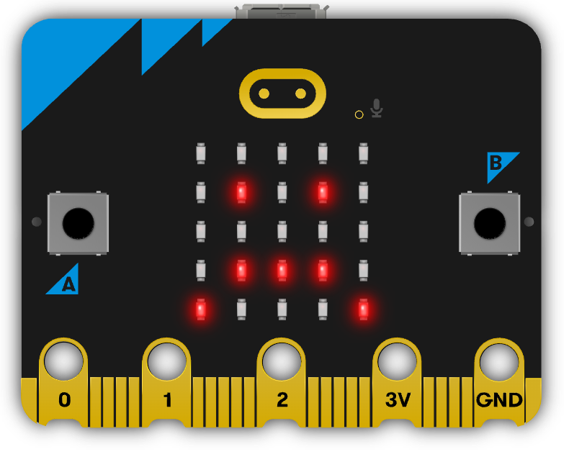

Think: sharing feelings
Today we’re going to make badges that show how we feel.
What emotions might we want to express?
Why could this be useful?
Notes:
Some people find it hard to express or read emotions and a badge like this can be helpful for them.

Slide 4

Think: learning objectives
I can make the micro:bit show different pictures on the LED display output depending on which button input is pressed.
I can explain that inputs are data sent to a computer.
I can explain that outputs are data sent from a computer.
Notes:
Ask your students what other inputs and outputs they can think of.
Keys on a keyboard, a touch screen or buttons on a game controller are inputs.
The display on a phone or game console, or sound from a phone or game console speakers are examples of outputs.

Slide 5




Think: introducing micro:bit buttons video
Optionally play video: https://youtu.be/hnT0qHM3_hQ

Slide 6
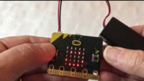
Think: emotion badge introduction video
Optionally play video: https://www.youtube.com/watch?v=wSXwc3rlJ7s

Slide 7

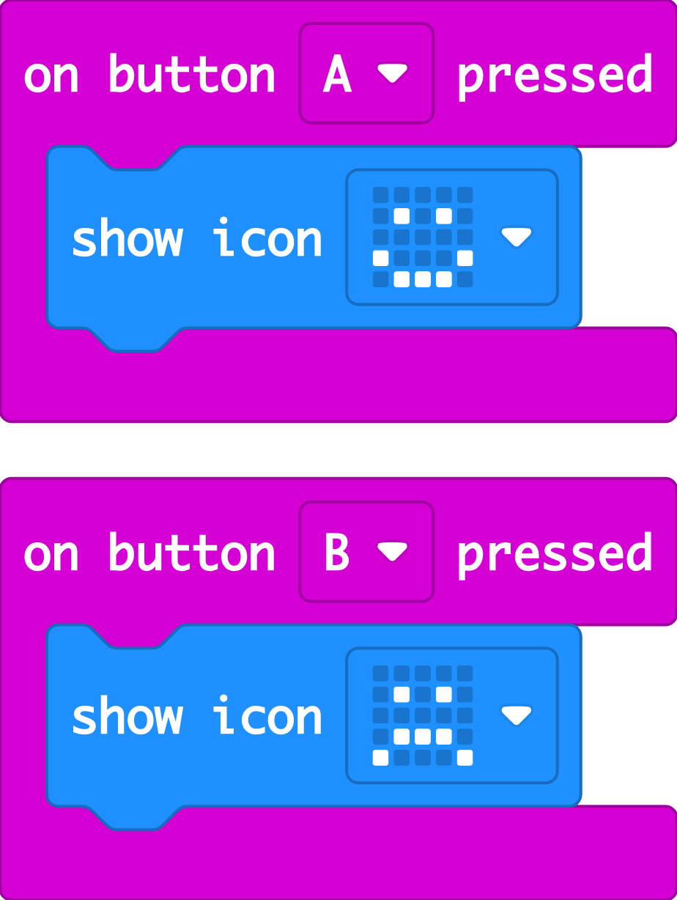

Create: examine the code
The ‘on button A pressed’ block makes something happen when you press input button A.
The ‘show icon’ block makes an image appear on the LED display output. You can choose different built-in images.
The ‘on button B pressed’ block makes something happen when you press input button B.
So you can make different outputs happen on the LED display when you press different button inputs.
Teacher: open the completed code in the editor
Notes:
You can follow the link to open the completed code in the editor and test it in the simulator.

Slide 8

Create: build the code
Open a new MakeCode project https://makecode.microbit.org/
Notes:
You can follow the link to open a new MakeCode project and model building the code yourself – or use slide 9 to show a YouTube coding video, or slide 10 to show an animated GIF of building the code if YouTube is blocked in your school.

Slide 9

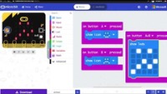
Create: coding video
YouTube coding video: https://mbit.io/lessons-emotion-code-video
Notes:
Optionally share this YouTube coding video with your class: https://mbit.io/lessons-emotion-code-video

Slide 10


Create: coding animation
Notes:
Animated GIF of building the code you can share with your students, if YouTube is blocked in your school.

Slide 11
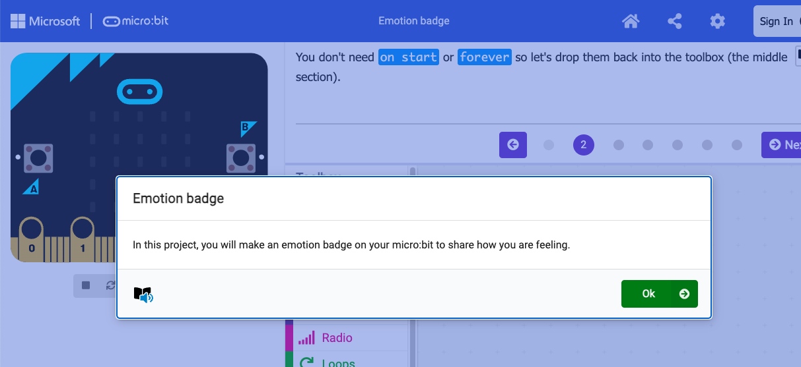
Create: step-by-step online tutorial
https://mbit.io/tutorial-emotion-badge
Notes:
You can optionally share this online step-by-step tutorial with your students to follow individually.

Slide 12



Evaluate
Download your code to a micro:bit
Does it work as you expect?
How good is the project?
Could it have other uses?
How does it work?
Notes:
Does it work as you expect?
If not, do you need to debug the code and download it again?
How good is the project?
Would you recommend it to a friend?
How could you improve it?
How does it work?
Encourage students to think about how it works when holding it in their hands.

Slide 13

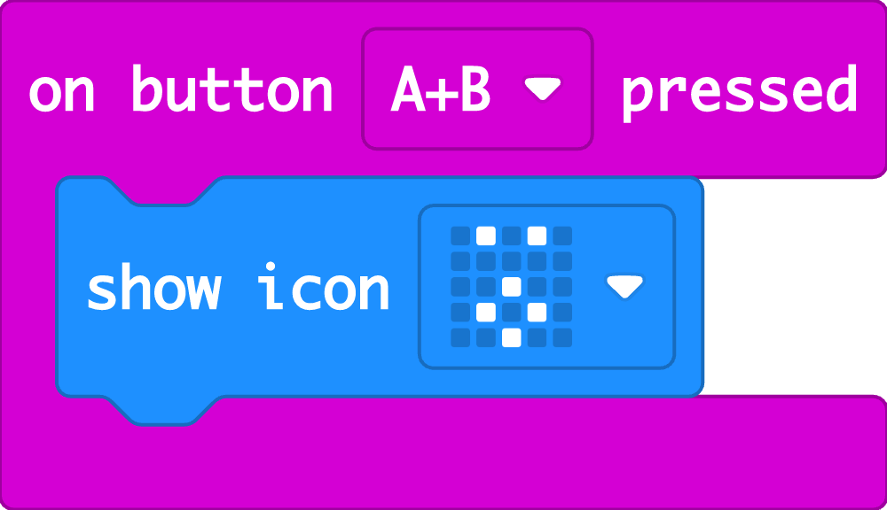

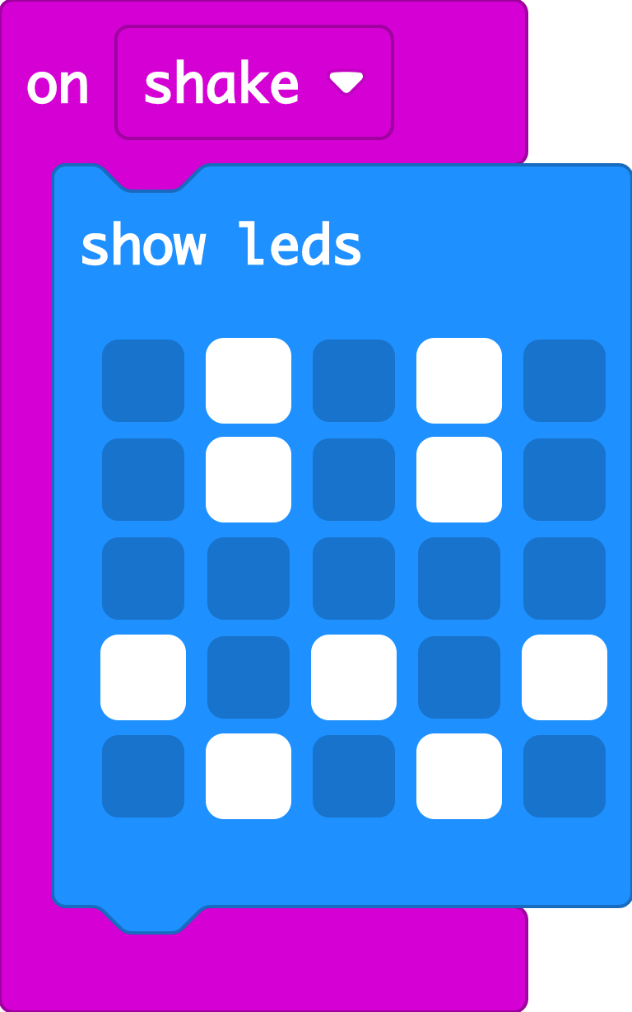

Extend
Add more icons when you press A + B input buttons together.
Design your own emotion images on paper. Code them using the ‘show LEDs’ block.
Can you make another emotion appear if you shake your micro:bit?
Notes:
You can use the LED grid planning sheet download or any paper to draw new emotion images.
To add a shake input, use the ‘on shake’ block in the Input section of MakeCode.

Slide 14

Share: revisit the learning objectives
I can make the micro:bit show different pictures on the LED display output depending on which button input is pressed.
I can explain that inputs are data sent to a computer
I can explain that outputs are data sent from a computer.
Notes:
Ask students:
How did they make their micro:bits show different images? (Using different buttons and the ‘on button pressed’ input code blocks)
What are inputs? (Data sent to a computer for processing such as button presses and sensor readings. Examples of inputs include the buttons on a game controller or the touch screen on a phone).
What are outputs? (Data sent from a computer such as information shown on a display. Other examples of outputs include phone or game screens or sound from speakers)

Slide 15

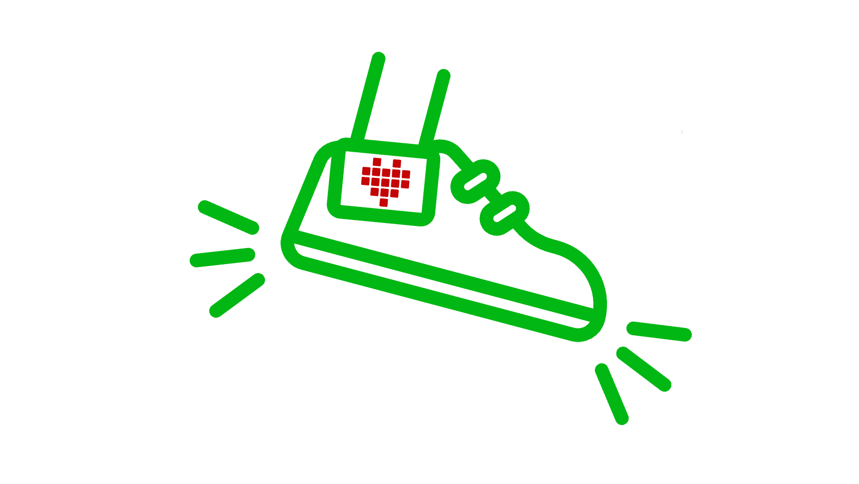
Next steps
Today we used some of the micro:bit’s inputs, to make different pictures appear when we press different buttons.
Next time, we’re going to use the input that can sense when you shake your micro:bit to make a simple step counter: the accelerometer.

